Slide 1
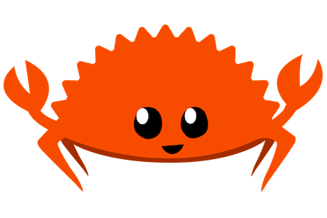
Crabby Server
"An excessive emphasis on invention, rather than on adoption, is a major factor in the low success rate of innovation.”
- Peter Denning

Slide 2
Objective
1. Create a single threaded rust server
  - Follow the tutorial: https://doc.rust-lang.org/book/ch21-01-single-threaded.html
  - Only the single threaded server is required.
2. Build at least two html webpages.
  - main page (index.html)
  - page linked to by main page
3. Have two links from the main page (index.html).
  - This is a good tutorial: https://www.w3schools.com/html/html_links.asp
  - Pass a unique message on each link.
  - Modify the linked-to pages to display the passed message in their html code.
4. Serve the webpages from your web server
5. Add a simple interactive javascript element on any one of your web pages.
  - It can be as simple as a popup when you press a button.

Slide 3

Web programming overview

Slide 4
Server and client
* Clients listen on a ‘port’. For example: 127.0.0.1:7878 or localhost:7878
  127.0.0.1 means localhost, or the local client machine.
  7878 is the port number

Slide 5
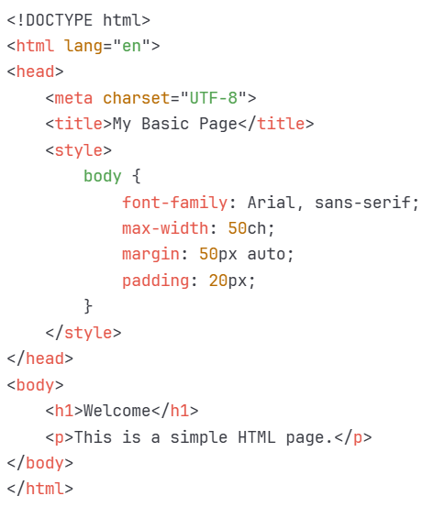
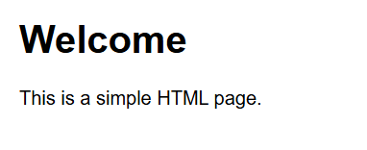
html

Slide 6
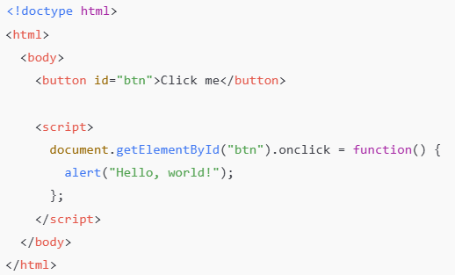
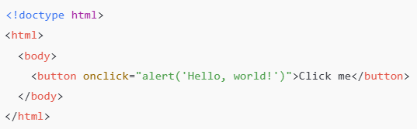
Where does javascript execute?
These two scripts do the same thing.

Slide 7
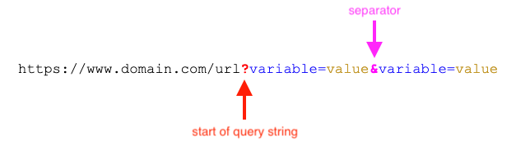
Passing information to server

Slide 8
deliverables
* Email to richard.thompson@nps.edu
* Link to github with your code.
* Screenshots showing:
  both webpages
  interactive javascript feature

